Slide 1
Introducing enableHR
NOTE: This presentation is intended to be used for Leaders & Managers only.

Slide 2

Why enableHR?
We’ve introduced this new software because it will speed up and simplify a lot of routine HR administration, make record-keeping and compliance easier, and provide us all with many useful HR and safety tools and resources.

Slide 3

What is enableHR?
enableHR is a cloud-based HR software designed to make HR simple! In a nutshell, enableHR:
Makes us compliant – compliance is complex, and it can be easy to make a mistake, misinterpret an award or miss the latest amendment to some regulation or other. With the resources inside enableHR, we now have everything we need to be 100% compliant.
Save time, efficiency and productivity – this software will help us to focus on our people, not the time-consuming HR admin tasks! It’ll save us time, make managing our employees easier, and let us get on with running and growing the business.
Secure and reliable – enableHR is hosted by Amazon Web Services, delivering speed, security and reliability. Our information is backed up in multiple locations in Australia. Whether stored or moving, our data is kept safe and encrypted with layers of industry-leading encryption and role-based access permissions.
Access to excellent support – enableHR has a team of experts – Client Success – they will be there should we need help with the software, training or any other questions we have.

Slide 4

How does enableHR work?
enableHR is cloud-based software, which means we don’t install anything on our computers and our company’s data is safe in the cloud. enableHR is used through a regular web browser on any internet-connected device.
The software has a Management portal (also known as core enableHR) which stores our company HR policies and all our employee records. It also provides workflows to guide Managers through smart, legally compliant HR processes.
The software also has an employee Self Service portal (also known as eSS) which Managers can use to communicate with employees and set them tasks to complete in eSS.

Slide 5

How will enableHR’s Management portal impact you?
Leaders and managers
When we launch enableHR, you will have access to a wide range of elements including:
A powerful cloud-based HR management platform that uses workflows to guide you through smart, legally compliant HR processes, communicate with employees and set them tasks. It will store all our employee records, automate a lot of tasks, and has sharing features that let managers (and employees) easily access, deliver and receive documents and files.
The ability to log in to the platform anywhere, from any internet connected device;
The ability to view and manage employee HR files for your direct reports;
The ability to manage day-to-day HR-related tasks against an employee’s HR file;
A library of resources inside the platform that include employment law checklists, workflows, letter templates, guides and fact sheets. These include step-by-step guides on how to handle a range of situations using best-practice and legally compliant processes;
It’ll save us time, make managing our employees easier, and let us get on with running and growing the business knowing that we’re following best-practice HR processes;

Slide 6

How will enableHR’s eSS portal impact our staff?
Employees, volunteers and contractors: [←delete any that don’t apply]
When we launch the software, employees will be able to log into an employee section of the platform, known as Employee Self Service (eSS), where they can:
View company policies on various things including [insert description of what’s available]
View and update their personal details (including your address, bank account for example) as well as access select documents stored against their HR file (such as their signed employment contract)
View and action tasks assigned by management or HR such as acknowledging policies and electronically signing documents.

Slide 7
What’s inside of enableHR?
enableHR does everything when it comes to
people management.

Slide 8
How will enableHR be launched?
Launching in phases
Launching any new software within a business has its challenges – and that’s normal! As you can see, enableHR can do everything when it comes to HR.
To ensure that our Managers and employees don’t get overwhelmed, we’ll introduce enableHR in phases.
Phase 1: Employee Management Portal & eSS only
Phase 2: [insert module and description of what will be launched next]
Phase 3: [insert module and description of what will be launched next]
Similar to this current phase, more information and training on the other modules will come in future phases.

Slide 9




Phase 1: What we’re launching now?
Account Set Up
Launch
+
=
Management Portal: Employee Management
+
Employee Records:
Virtual HR Files
Company & Employee Documents
Employment Law Resources
Employee Self Service (eSS)

Slide 10

Employee Records & Documents
Employee Records are the heart of enableHR. We’ll have a single source of truth, a central repository of data for all our employees, contractors and volunteers. Paperless, cloud-based and secure, our records will be consistent and up to date across the business, even if our people work between home, different worksites or different cities.

Slide 11


Company HR & Workplace Policies
Policies: Our business and brand is protected by a range of compliant policies built into enableHR. From policies on Alcohol & Other Drugs, EEO, Discrimination, Bullying & Harassment, to Working From Home, Social Media and everything in-between – enableHR has us covered. They’ve even compiled them into a digital Employee Handbook. Powerful creation and editing options allow us to adapt any policy to suit our business, write new ones and control distribution across to our employees.
Company HR Documents: enableHR now stores all of our general HR company documents which include [insert description of what’s been uploaded]. From now on, you will find anything HR related in enableHR.

Slide 12

People Management
While enableHR’s performance management tools will keep us compliant and protected, their true power lies in promoting those face-to-face conversations that help us get the best out of our people. We aim to build a high-performance culture by getting to know who our employees are, and who they want to be at work and in their lives.
Creating conversations: Once implemented, we can manage employees in a positive, proactive way with the powerful Notes & Reminders feature. Notes & Reminders integrate with the formal process and give us the flexibility to manage our people the way we want to. Notes to capture those casual conversations, turn them into tasks (if you want).
Transforming the employee experience: Open and transparent discussion about employee goals and objectives help people feel secure and valued. Implementing enableHR will allow employees to grow personally and professionally and give them a place in which to formally express their goals and ambitions within (and outside of) the organisation. It’s the perfect way to start a conversation, and a perfect springboard to help managers step up and become leaders.
Managing poor performance: Sometimes employees struggle. So enableHR has workflows to guide us in what to do, from simple scheduling and recording of informal and formal interviews, to creating performance management plans to help employees get back on track.

Slide 13
Onboarding
enableHR allows us to smoothly recruit and onboard new people in all steps in the new employee onboarding lifecycle with the following features:
Recruitment: enableHR helps us easily manage recruitment, from creating new positions, to submitting requests and approvals. There’s Seek integration, and once we have applicants, there are workflows and guides to screen them, send automated emails and get us interviewing & shortlisting candidates quickly and efficiently.
Employment contracts: We can make offers and create contracts, with digital signing and a secure portal where new employees can upload copies of relevant qualifications using any internet-enabled device.
Induction: Distribute company policies, training materials, safety notices and documents, and have the employee sign and acknowledge them digitally, from any device which automatically saves in their employment history.
Probation: Manage probation and set expectations with clear and comprehensive job descriptions and automated reminders for when probation is about to end.

Slide 14

Employee Self Service (eSS)
Up-to-date Records: People move to a new house, documents expire, circumstances change. When things change, employees can use ESS to quickly update their information, anywhere, anytime.
News & Alerts: From holiday messages to changes in company policy, safety alerts to automated reminders: we can use ESS to communicate the things we need to say to our people, when we need to say them.
View Policies: All company policies can be read and understood by employee through ESS. We can send alerts to employees when a policy is created or updated so they'll always see the latest version and can digitally sign that they've read and understood it.
Onboarding & Contracts: Fast and paperless onboarding where employees can easily view and sign employment contracts, business card requests, employee handbooks, and induction info.
Setting goals: Employees can set and track their personal and professional goals for Managers to review and approve.

Slide 15
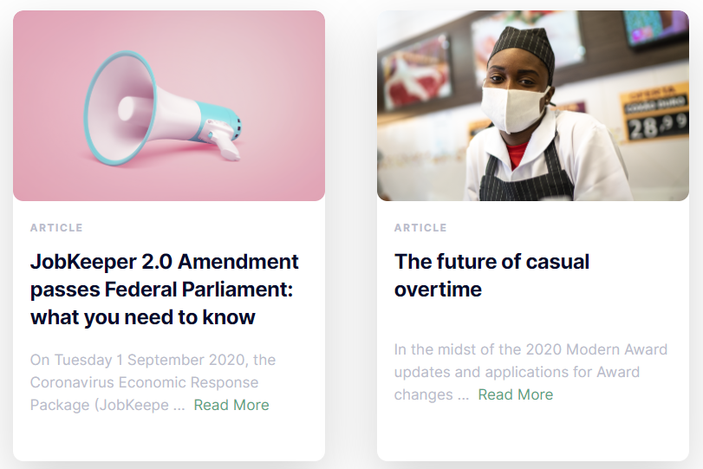
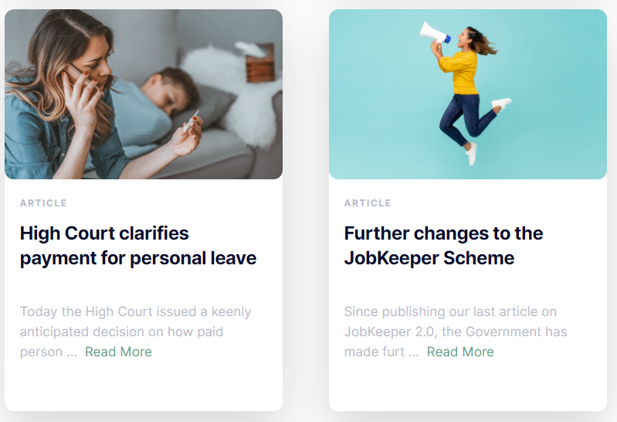
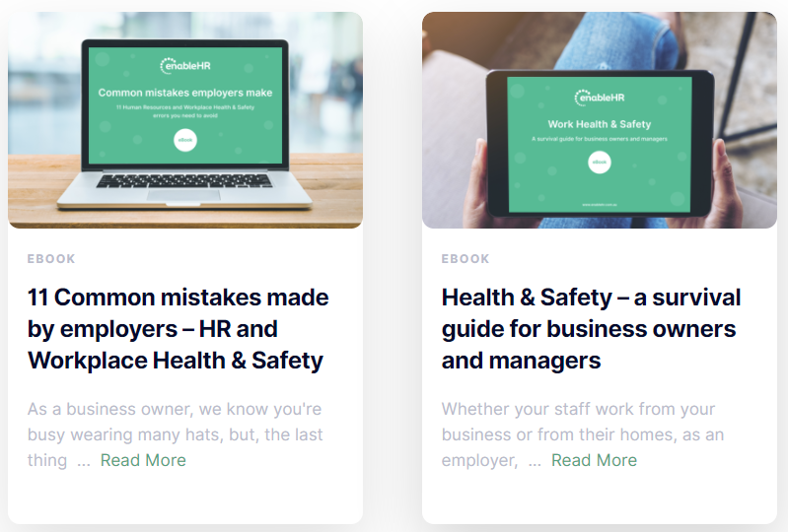
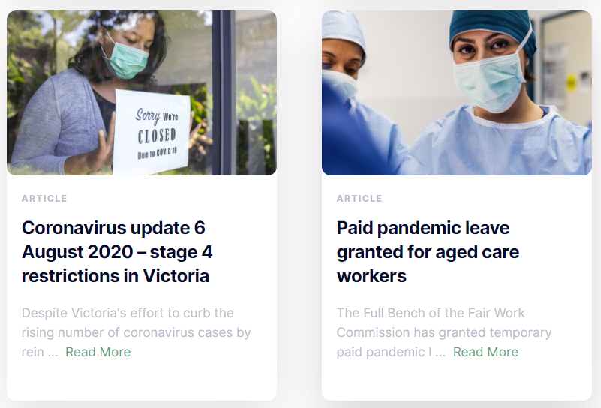
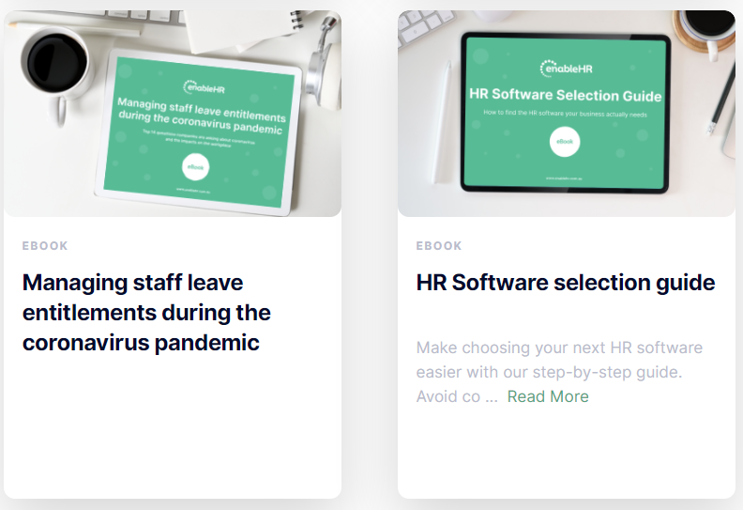
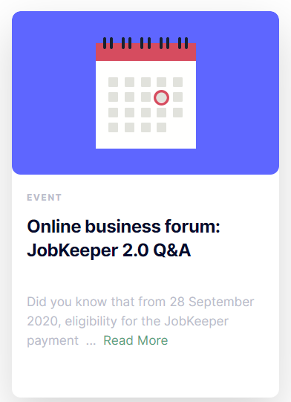
Additional resources
enableHR has a range of online resources available which can be accessed inside the enableHR platform, on their website (www.enableHR.com.au www.enableHR.co.nz) or on the knowledge base. Think webinars, blogs, articles, eBooks, and more!

Slide 16
So, what’s next?
enableHR Training: [Explain how you will roll out training – who will get it, when, and what it will consist of, e.g. workshop, online, etc.]
Your log in details: Managers will receive log in details via email on [insert time period].
eSS log in details: Your employees will receive their log in details via email on [insert time period].
Action the set tasks: As a Manager, it is really important that you complete the actions set out in your welcome email. You will also need to ensure that your employees also complete their actions within eSS. These tasks will provide a warm introduction to enableHR and will help you to familiarise everyone with enableHR.
On-Going Employee Management: You can then start to use enableHR in order to manage your employees going forward. [Explain your expectations of them going forward in relation enableHR]

Slide 17

For help with the software, please ask your champions
[INSERT NAMES OF YOUR CHAMPIONS HERE AND THEIR CONTACT INFORMATION]

Slide 18





Follow enableHR on social media!
linkedin.com/company/enablehr
facebook.com/enableHRAU
facebook.com/enableHRNZ
twitter.com/enableHR
twitter.com/enableHRNZ
instagram.com/_enablehr_/
youtube.com/user/enablehrdemo

Slide 19
For more information visit:
www.enablehr.com.au
www.enablehr.co.nz

